Slide 1
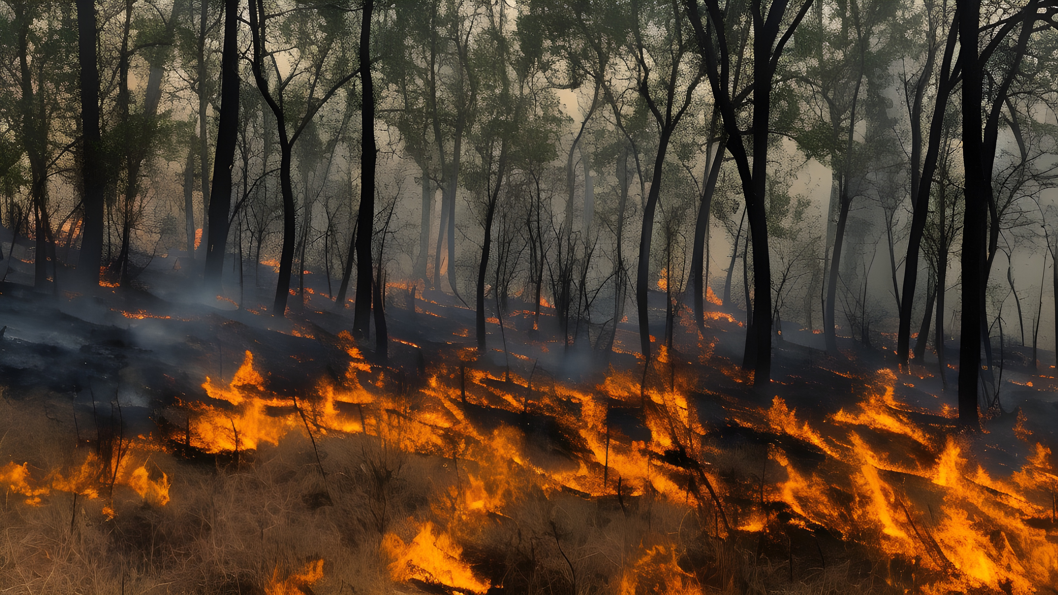
The impact of fire frequency on the root economic spectrum of herbaceous plants

Slide 2
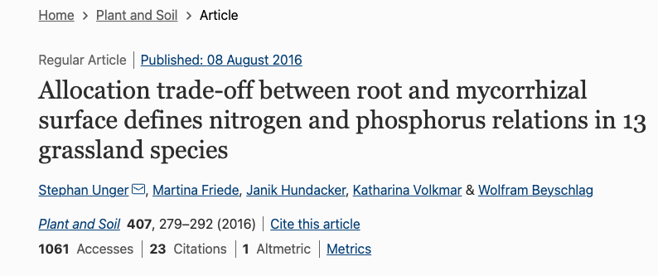
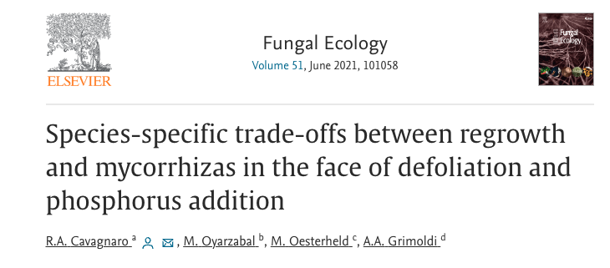
Theoretical Background
Ecological traits are coordinated and adapt along environmental gradients – root economic spectrum
Plants can dynamically change investment in roots and AMF symbiosis
Lack of understanding of how fire disturbance affects this tradeoff
“(((TS=("root economic spectr*" AND "fire")) OR TS=("collaboration conservation gradient" AND "fire"))
OR TS=("root allocation mycorrhiza*" AND "fire"))” gives 0 results on Web of Science, All Databases

Slide 3
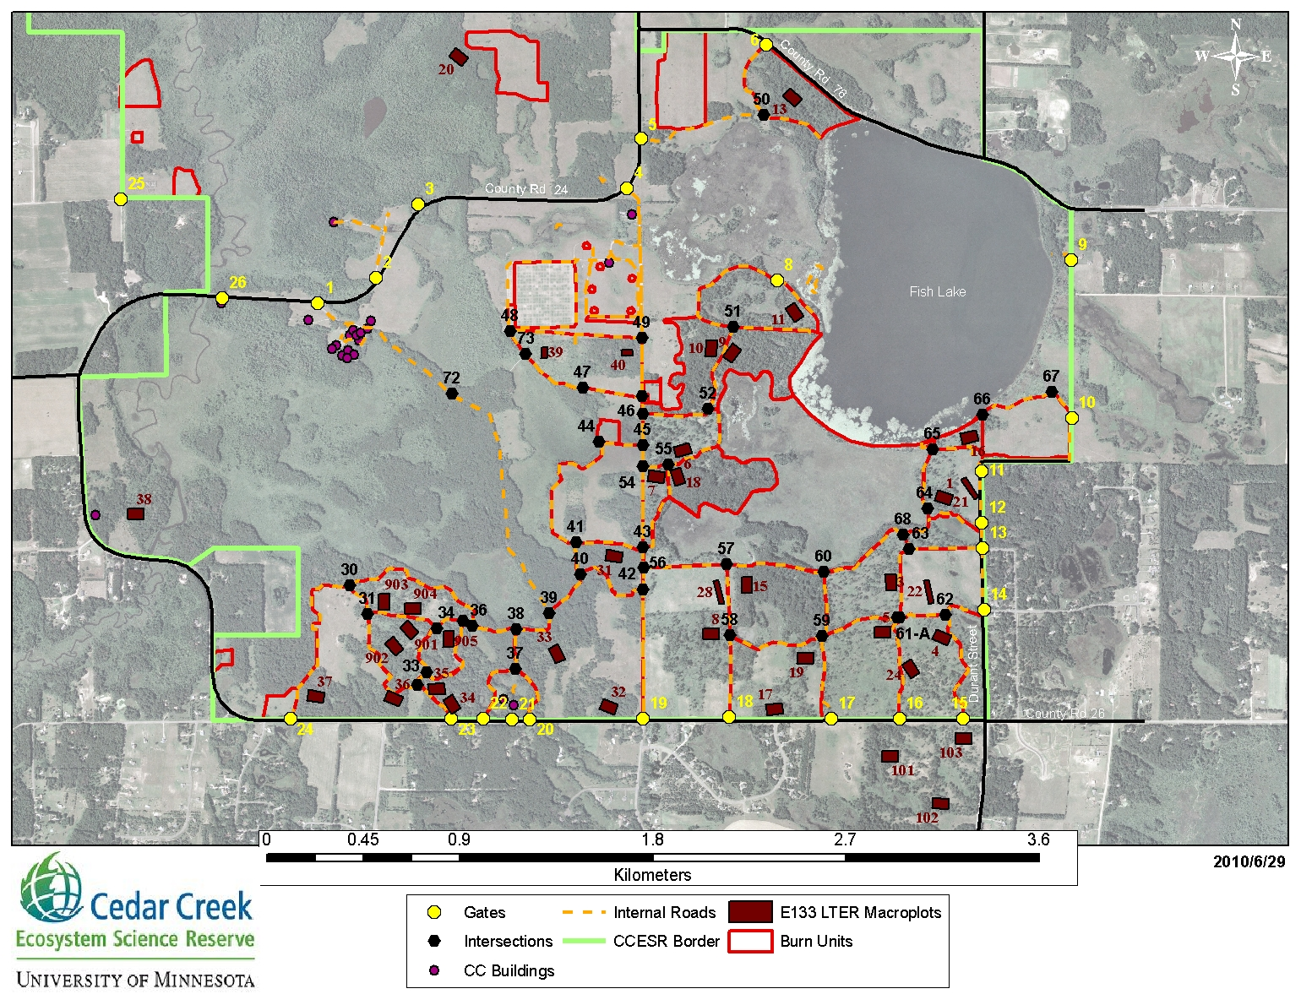
Study Site
Controlled burns since 1960s
12 burn unit sites, 6 fire frequencies
Lots of juicy data

Slide 4
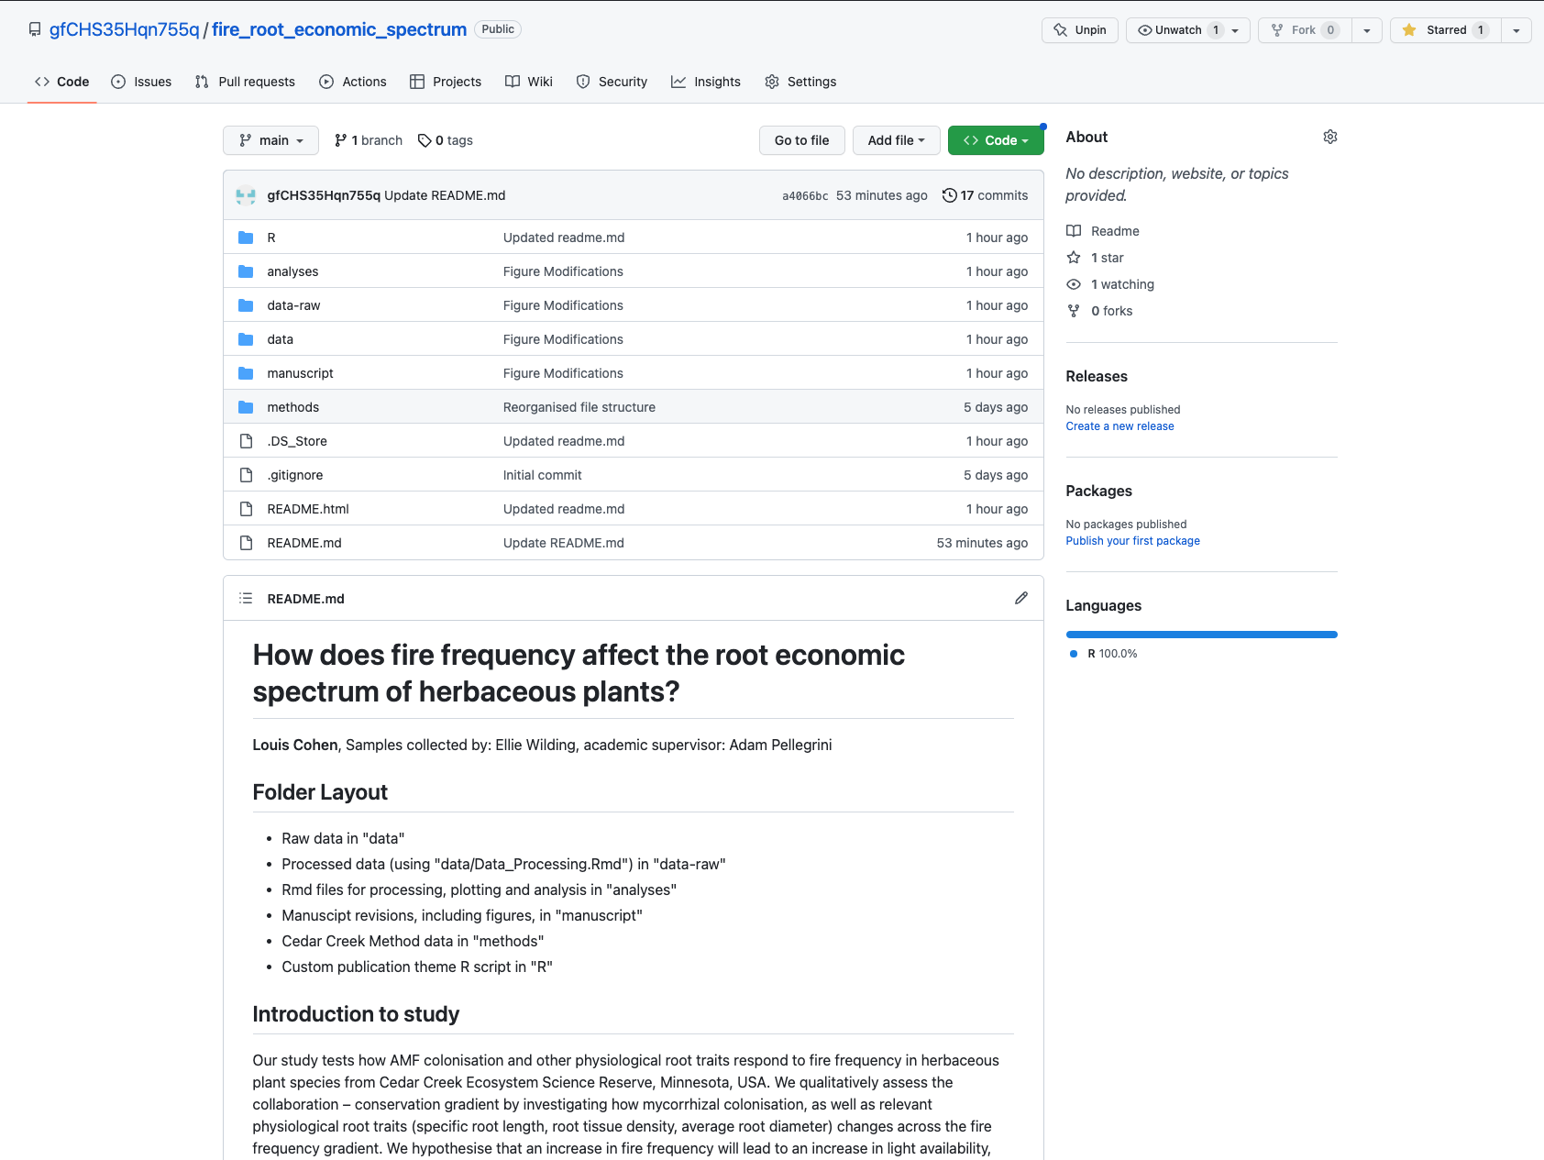

Thanks Jovana!

Slide 5
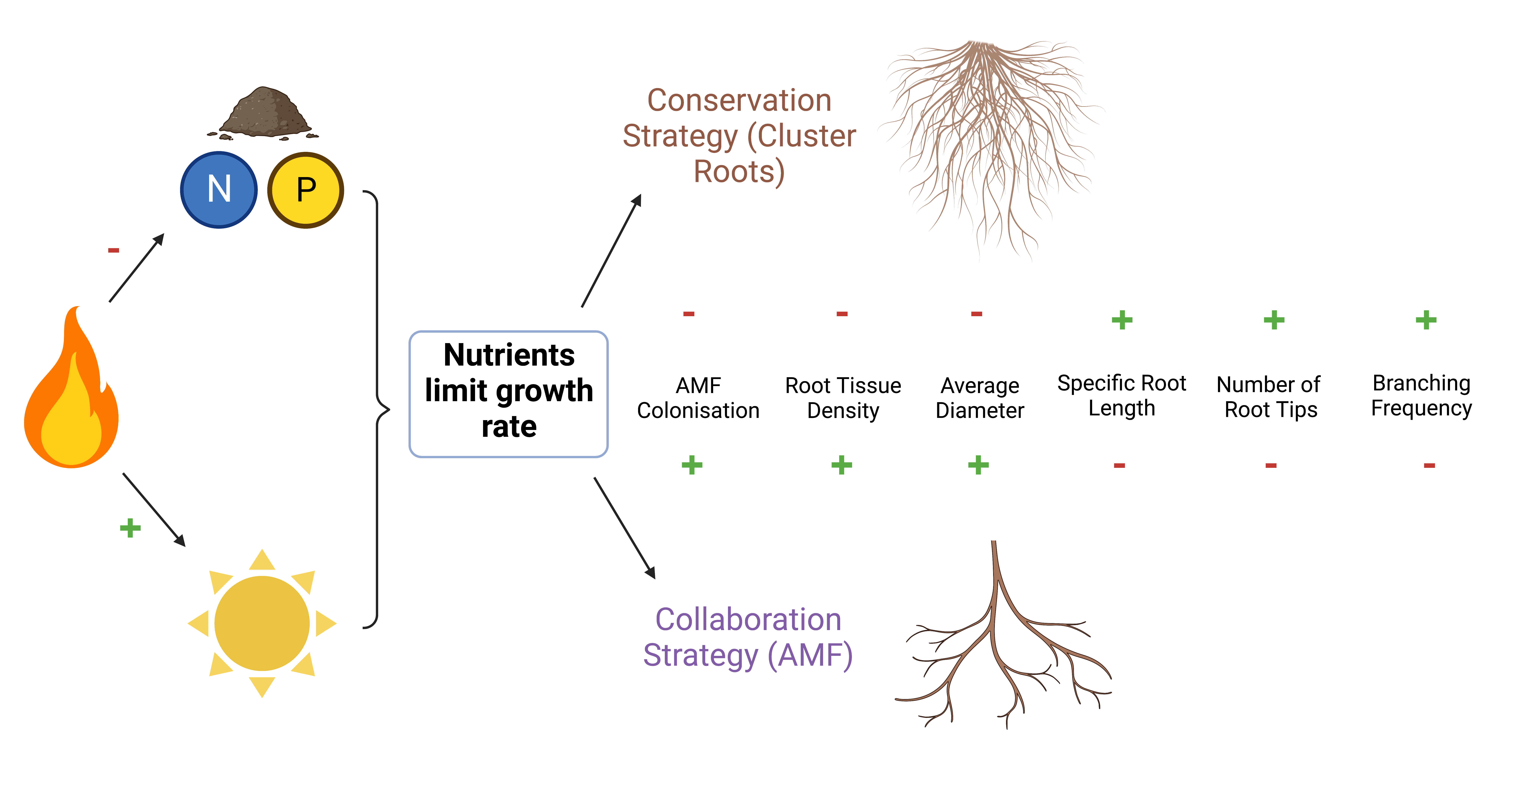

Slide 6



Methods – Environmental Dataset
Soil nitrogen, soil phosphorous and light uptake

Slide 7
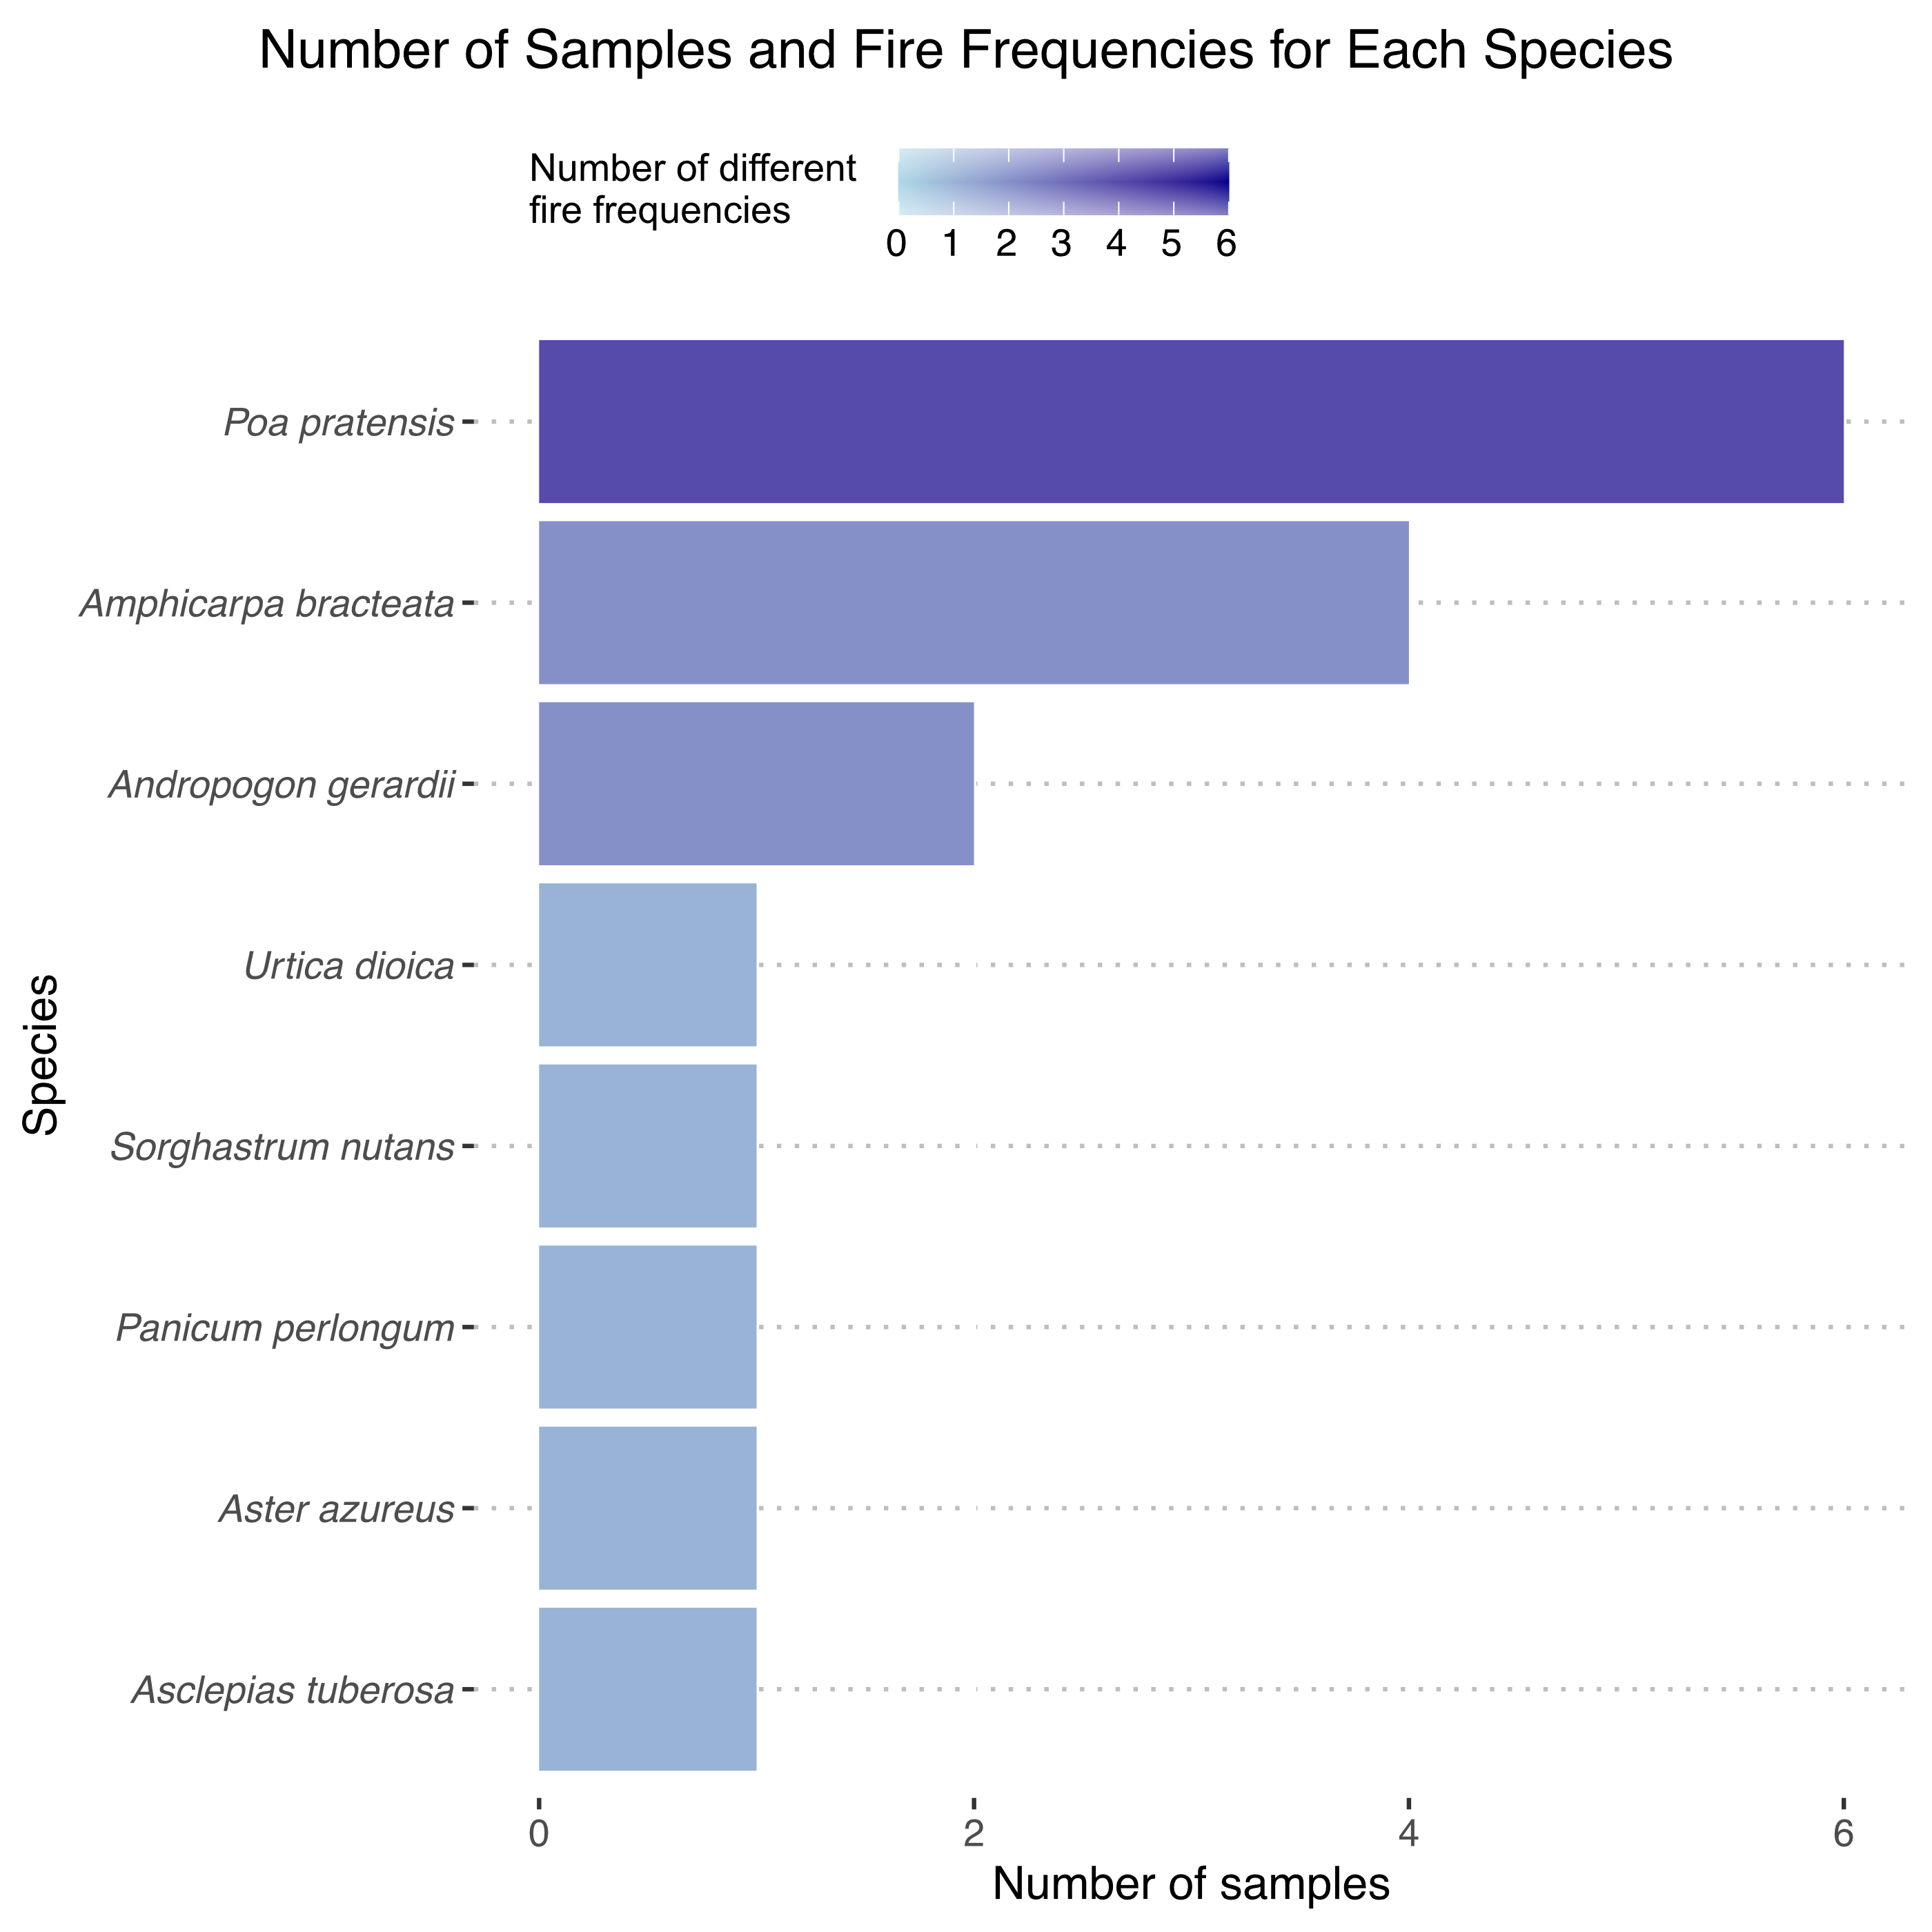
Methods – Experimental Dataset
Measured all roots traits
8 different species, 17 total samples (maximum 6 for a single species), 6 different fire frequencies (maximum 4 for a single species)
Notes:
Explain figure

Slide 8

Methods – Root Architecture Data - Scanning
Notes:
Struggles: laptop kept crashing, roots too thick

Slide 9
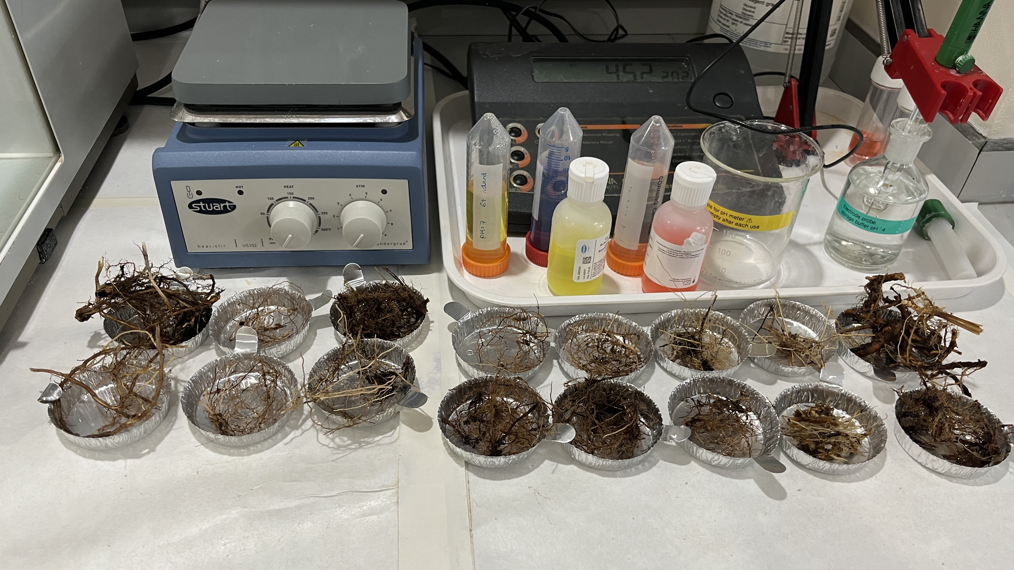
Methods – Root Architecture Data - Weighing

Slide 10
Methodological challenges – quantifying mycorrhizal colonisation

Slide 11
Staining

Slide 12
Mycorrhizal or pathogenic?

Slide 13
Spider Roots

Slide 14
Identifying a diverse range of AMF structures

Slide 15

Results and Discussion

Slide 16
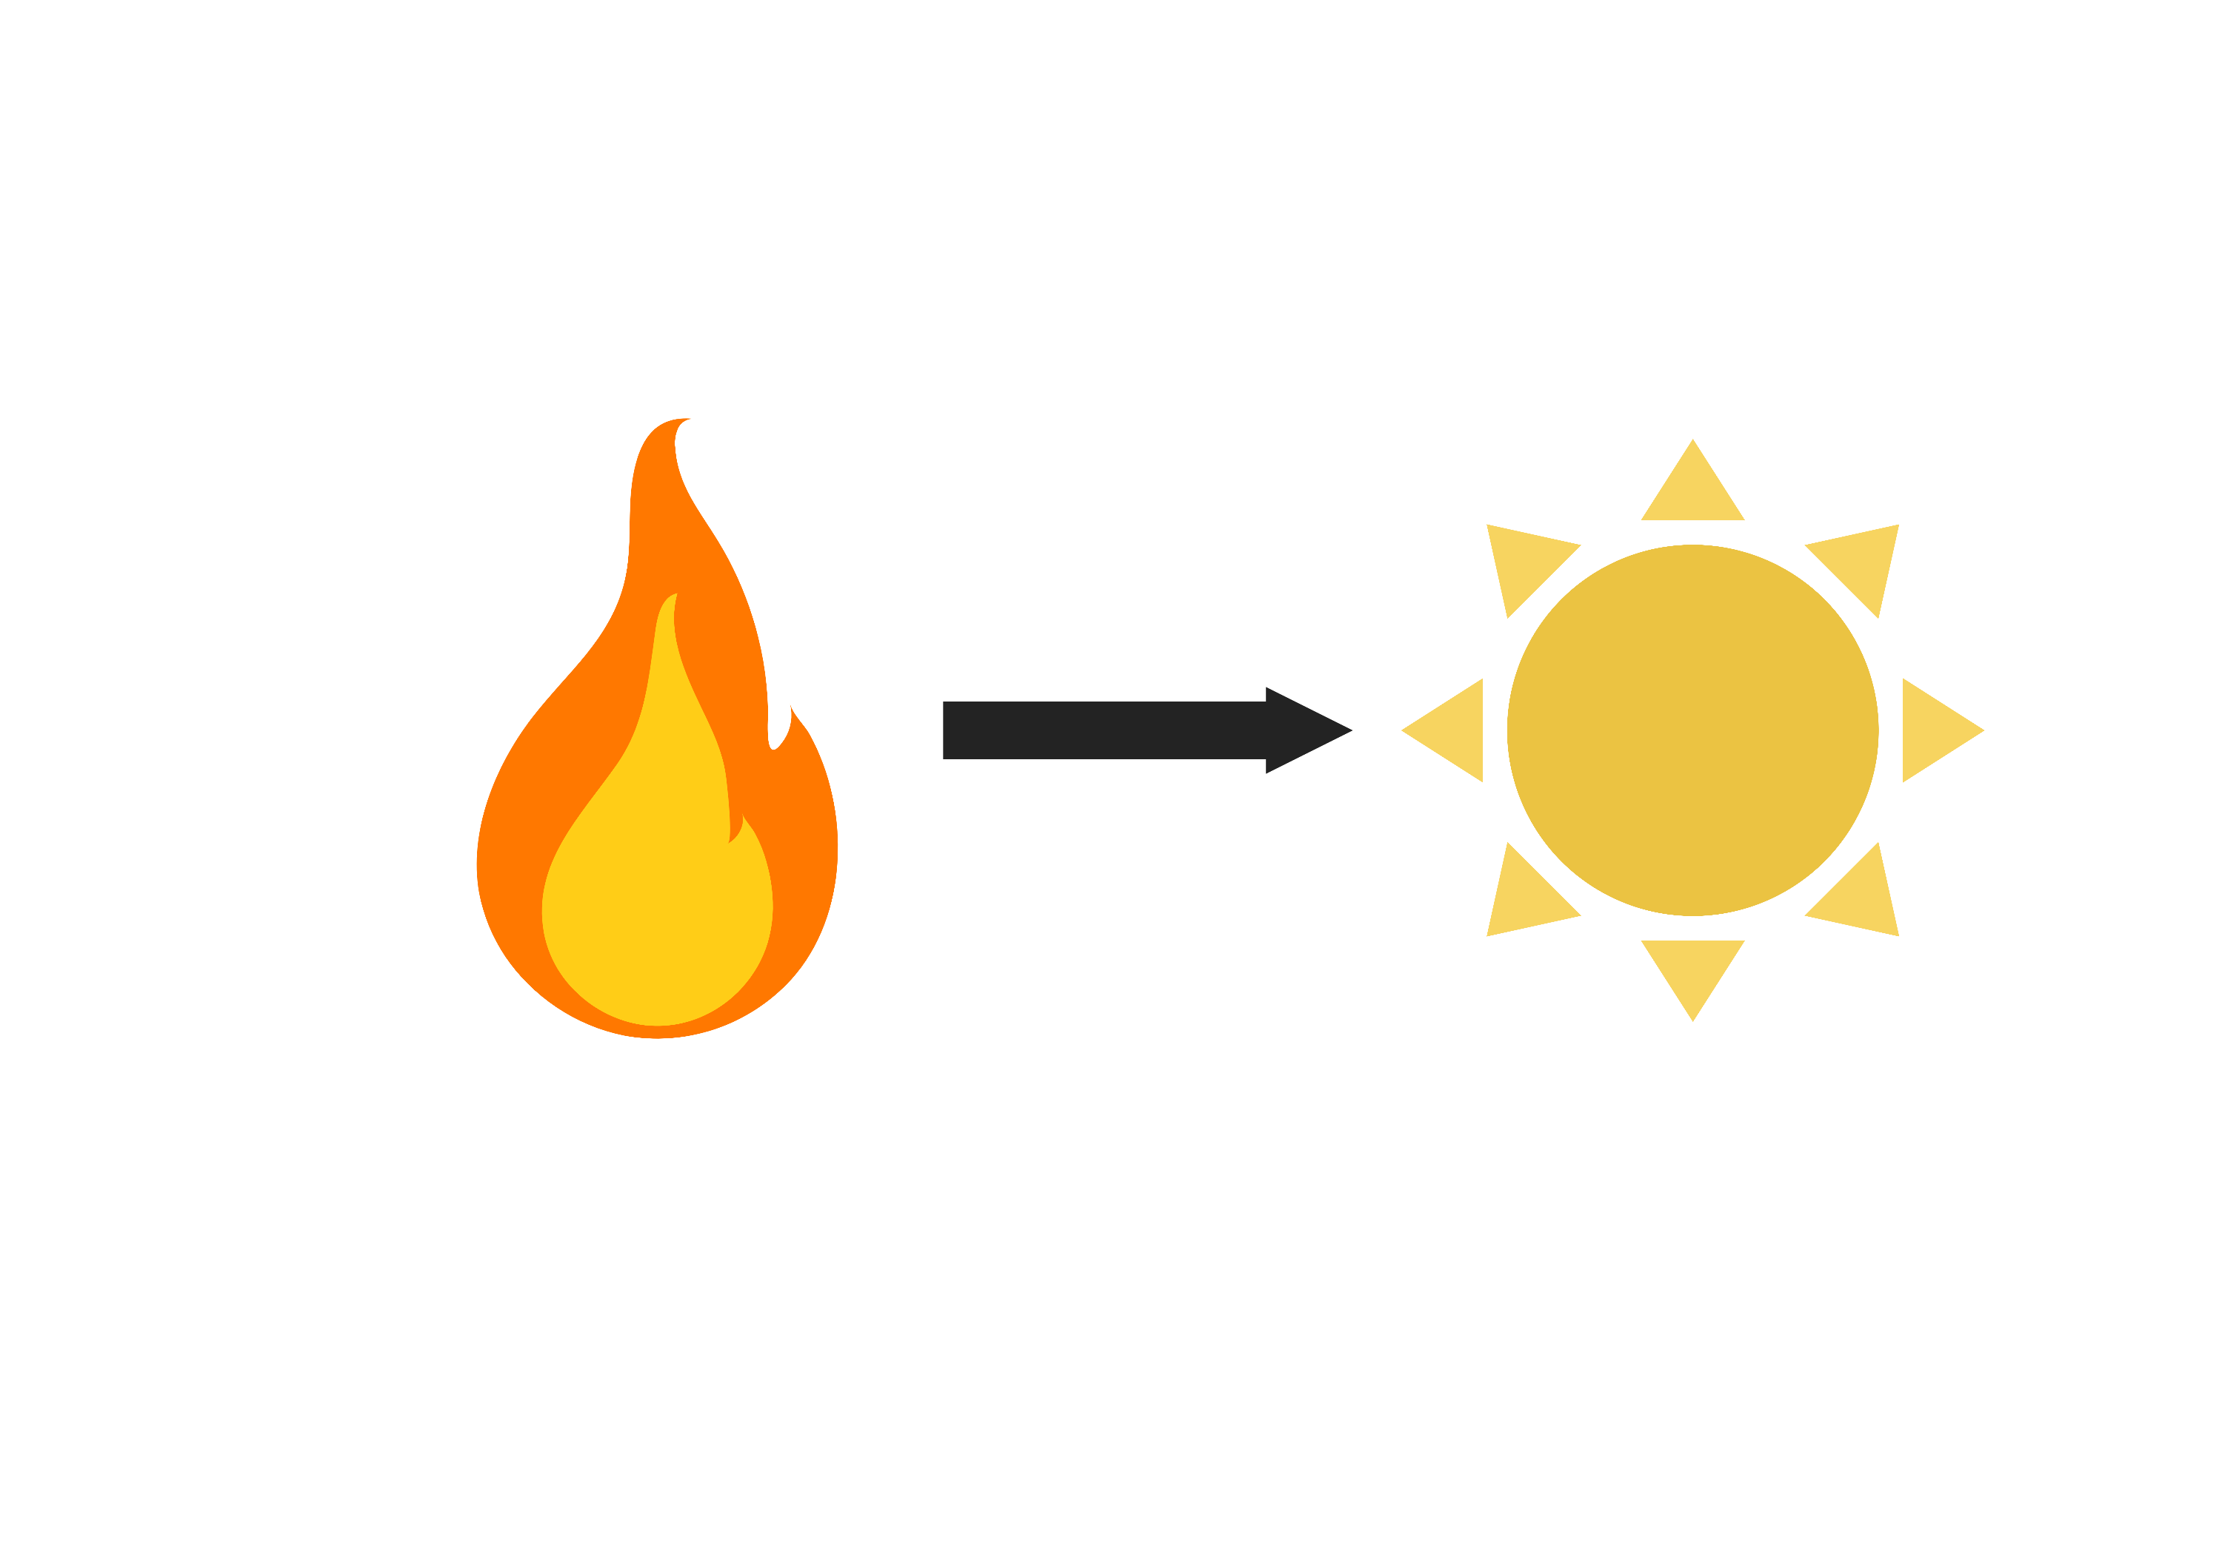
Positive correlation between fire frequency and light availability to herbs
Notes:
Not much interesting to say here, it’s what we expected and that’s good to see

Slide 17
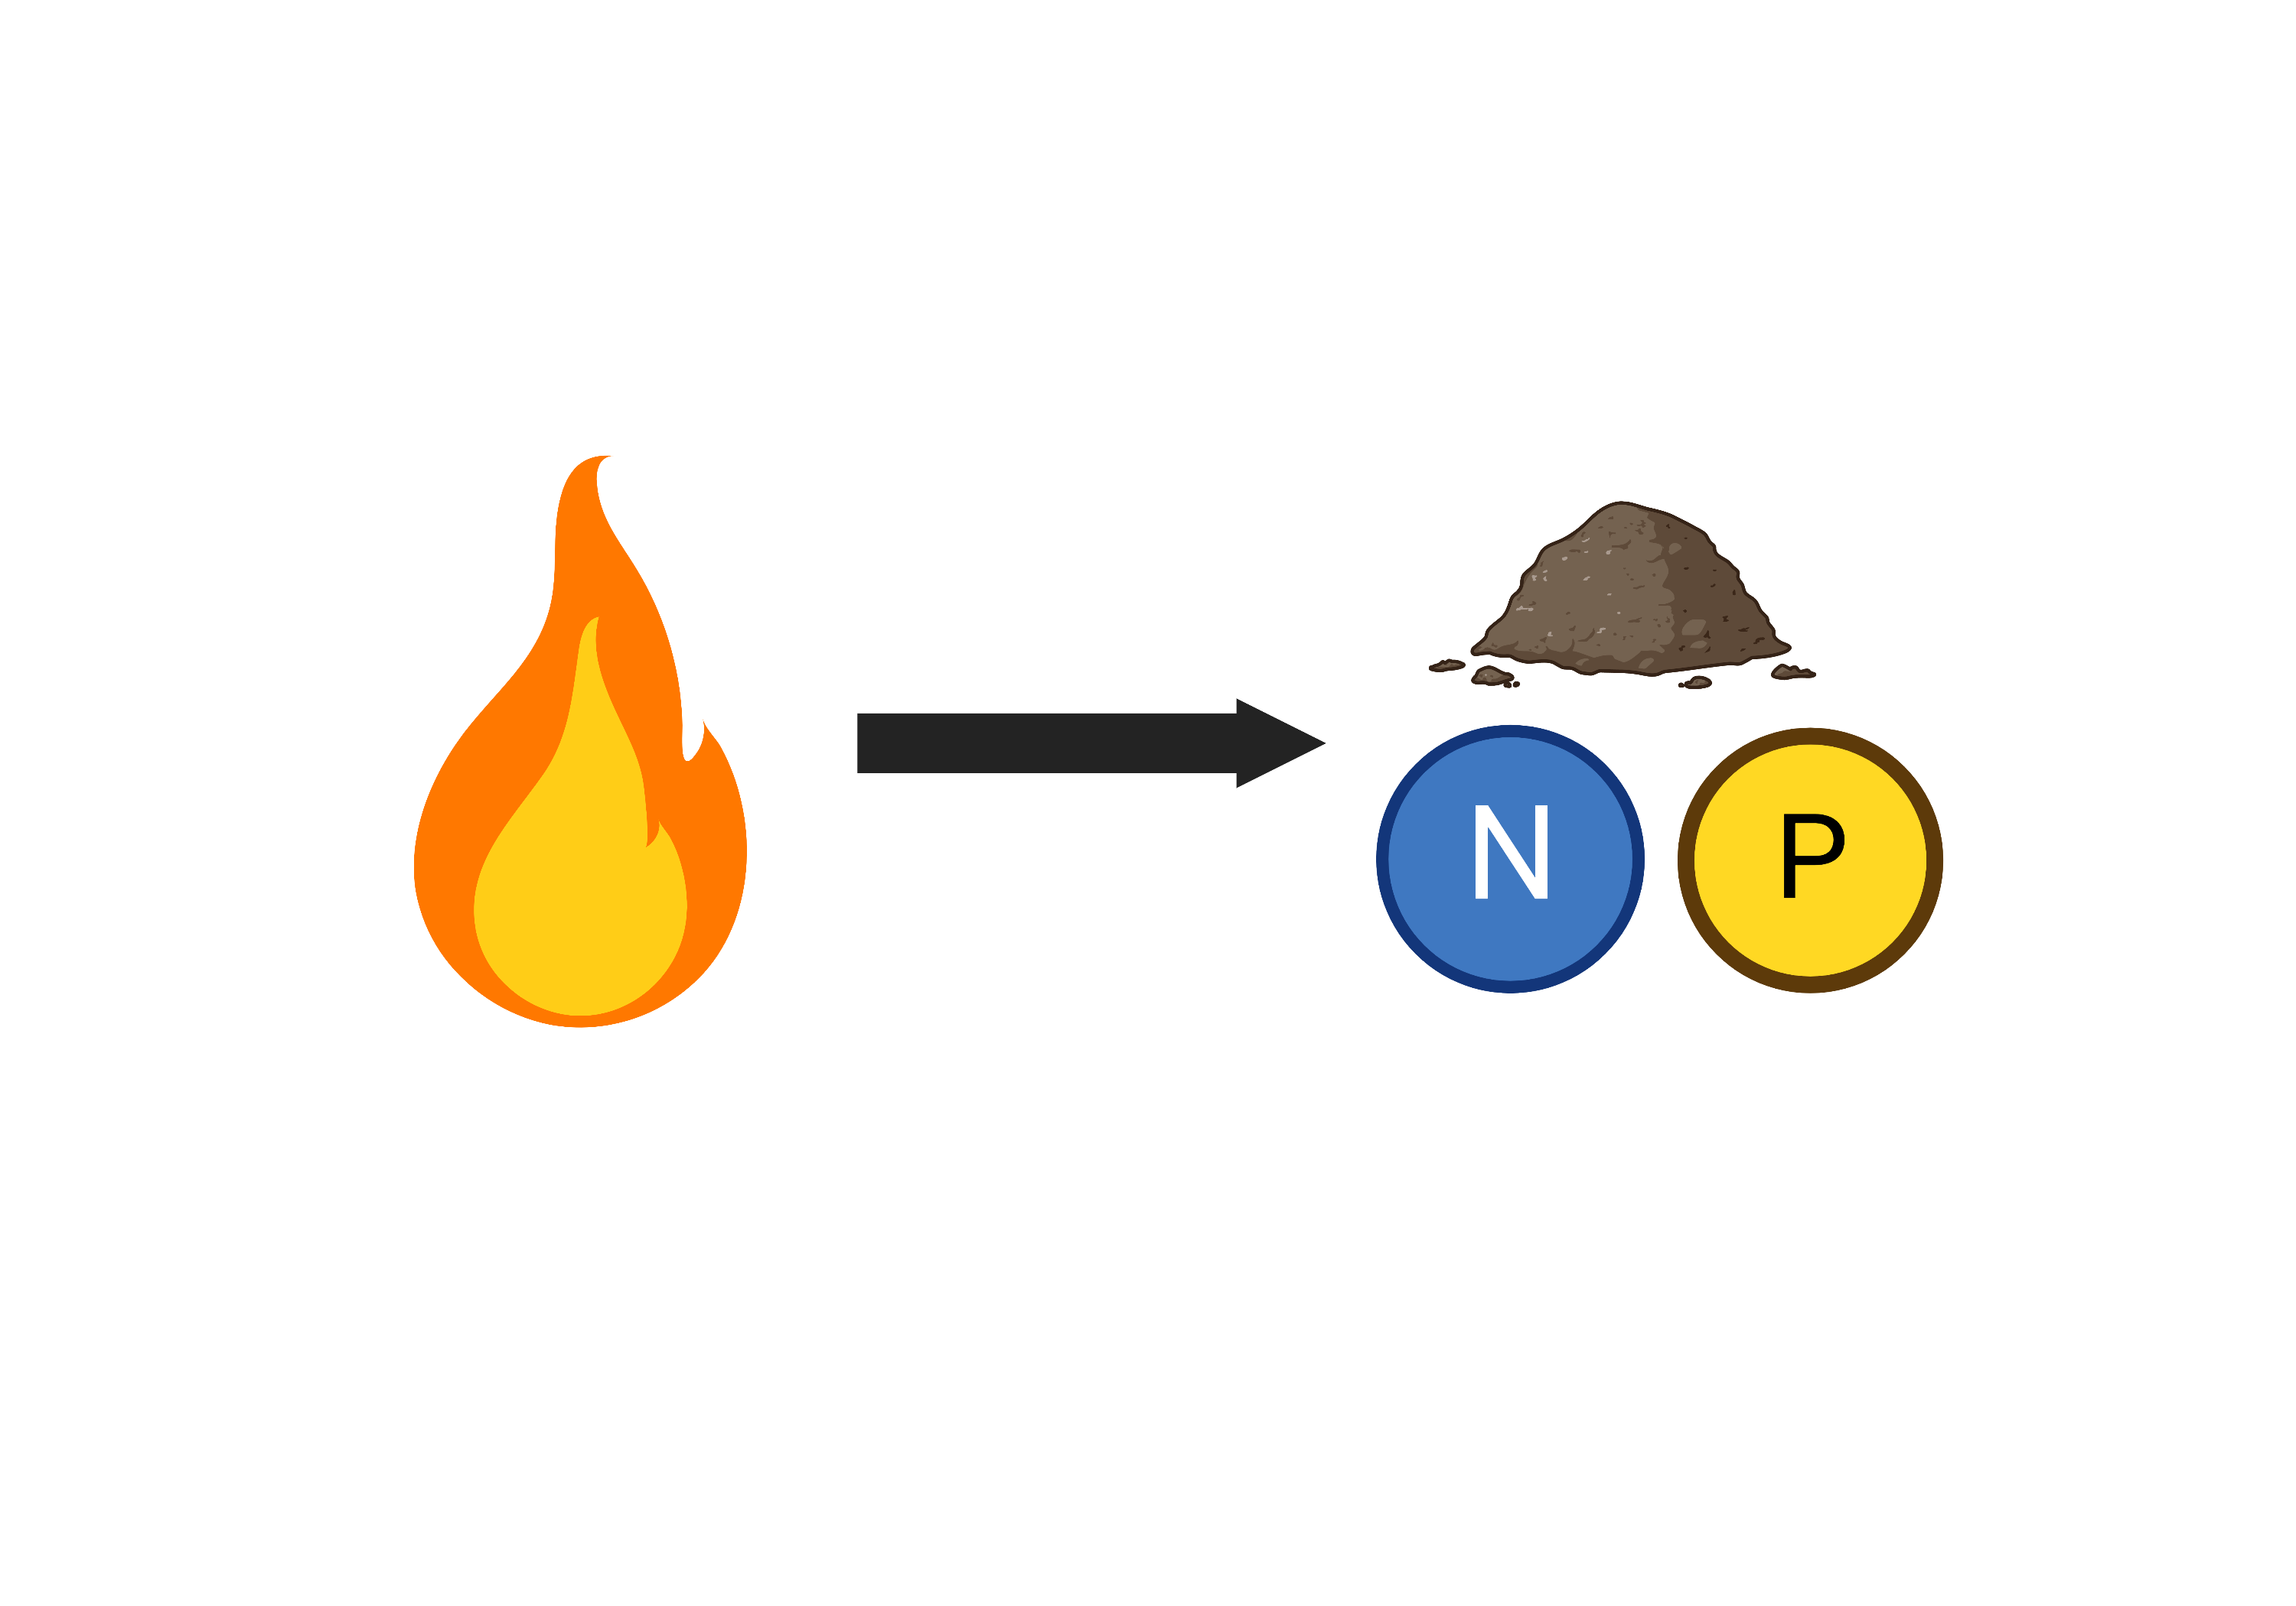
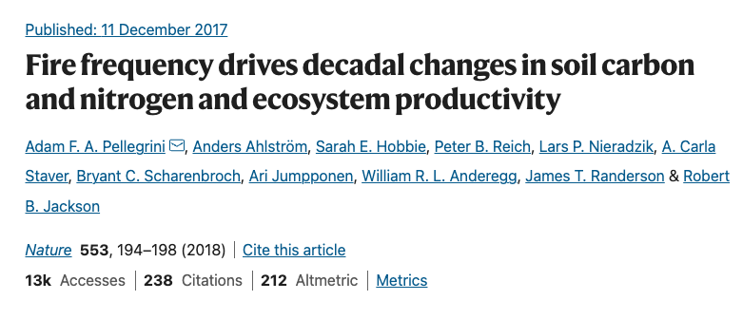
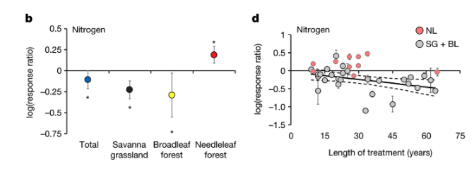
Increasing fire frequency is associated with decreased soil inorganic nitrogen
Notes:
What we expected
Maybe due to loss by volatisation?

Slide 19
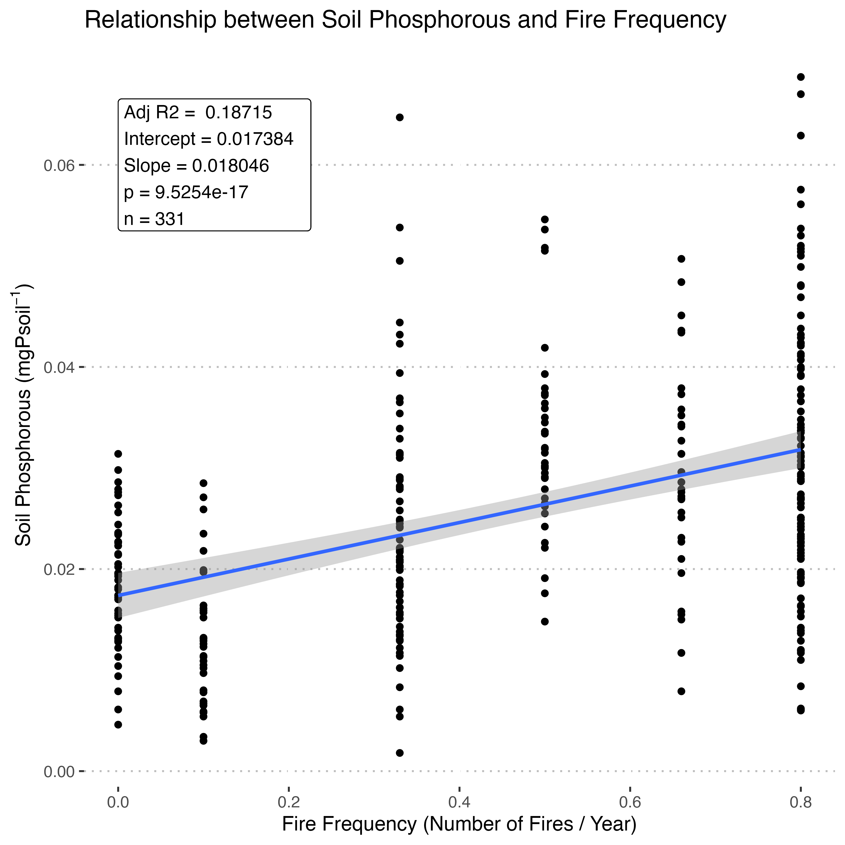
But increased phosphorous
Mean response ratio (%)
Notes:
Effect of fire on P reported to vary widely in the literature

Slide 20
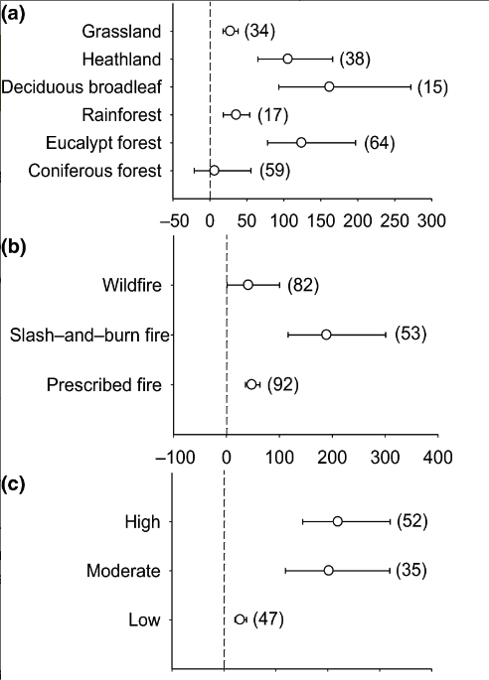
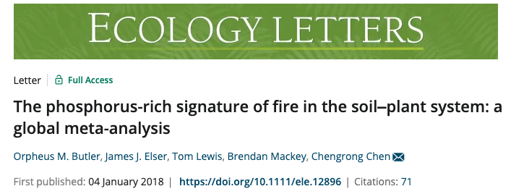

Slide 21
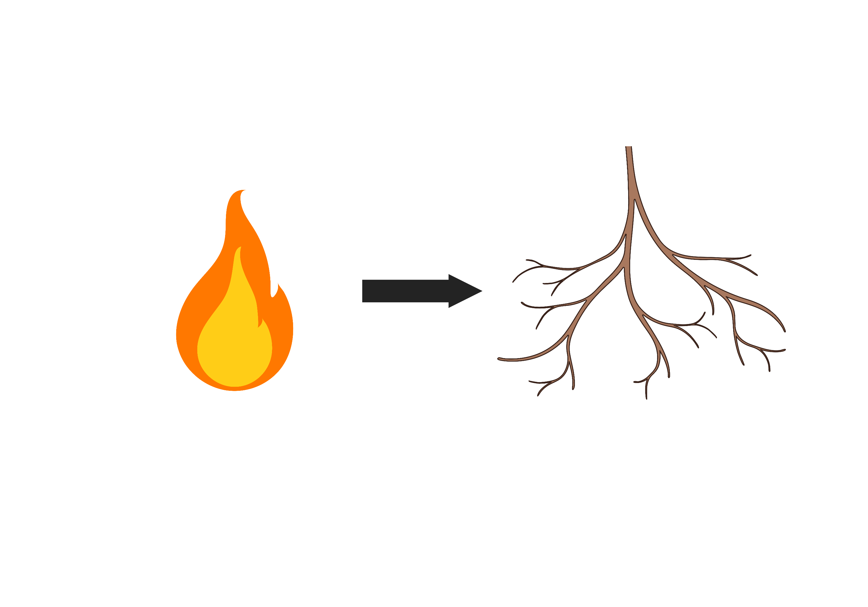
Non-legume forbs seem to be colonized less than other functional groups, but non-significant

Slide 22
No observable relationship when all species considered

Slide 23
But positive within grasses

Slide 24
and positive relationship in both species with enough samples

Slide 25
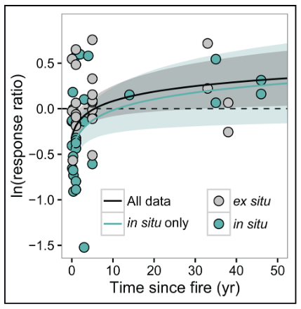
Relationship between fire frequency and AMF colonisation is complex and poorly understood
Dove NC, Hart SC. 2017. Fire Reduces Fungal Species Richness and In Situ Mycorrhizal Colonization: A Meta-Analysis. Fire Ecology 13: 37–65.

Slide 26
No significant correlation between root diameter and fire frequency

Slide 27
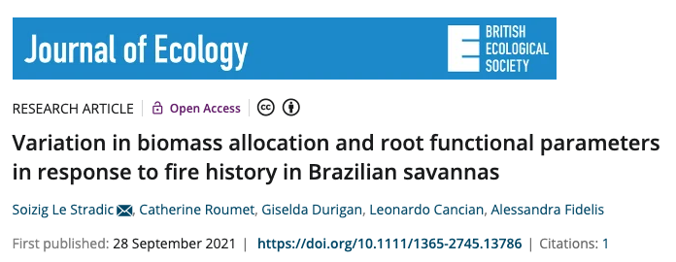
“Root parameters remained constant regardless of fire history but responded to variations in vegetation structure and soil properties”

Slide 28
Positive relationship between root tissue density and fire frequency
Notes:
Had to square root data as

Slide 29
No correlation for SRL as a whole

Slide 30
But negative correlation when we only include grasses

Slide 31
No observable correlation between number of root tips and fire frequency

Slide 32
No observable correlation between branching frequency and fire frequency

Slide 33
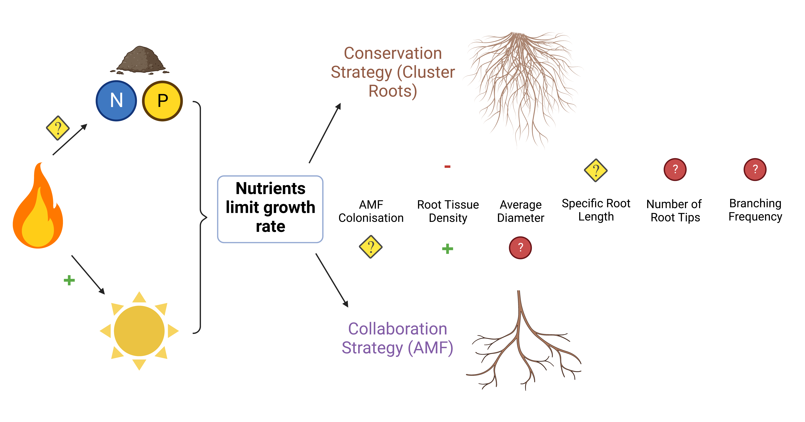

Slide 34
Discussion Points
Why does AMF colonisation show a positive correlation with fire frequency in grasses, but other functional groups do not? Possibly to do with nodules in legumes?

Slide 35
Questions
Quite basic linear regressions for all tests – any more interesting way to investigate the relationships?
Is it worth including a wider range of physiological root traits in my analyses?
Is it worth including more soil nutrients that have less relevance to AMF colonisation? (Ca, K e.t.c?)
How should I combat the linear models predicting negative values? Transform the data? Use a non-linear model?
How could I measure the root tissue density and average diameter of the very large tree roots? Is this worthwhile?
How do I account for one species (Amphicarpa bracteata), having root nodules, and therefore obtaining its own nitrogen without AMF?
Does microbial geochemical cycling make organic N available from inorganic N?
Haven’t accounted for phenotypic plasticity / natural selection

